Slide 1
PRIVATE SECTOR PARTICIPATION IN COMMUNITY ECONOMIC DEVELOPMENT
William A. « Bill » Ninacs
Coopérative de consultation en développement La Clé
Montréal, May 19 2016

Slide 2
WORKSHOP Plan
2
Concepts used
CED • the private sector
The path to employment as an analytical framework
personal and professional qualification
eliminating obstacles
accompaniment
favourable conditions for the creation of quality jobs
The challenge of integrated local development

Slide 3
CONCEPTS USED

Slide 4
COMMUNITY ECONOMIC DEVELOPMENT (CED)
key components:
• collective action targeting social change, based on partnerships within a regional approach, leading to structural changes in the medium and long term
• development of local capacity in the management of its resources
• deployment of economic measures to achieve social, cultural and environmental goals

Slide 5
PRIVATE SECTOR (1)
any non-governmental organization with market activities:
for-profit corporations
non-profit organizations with market activities
co-operatives
partnerships
sole proprietorships

Slide 6
PRIVATE SECTOR (2)
Types of businesses by size:
large (500 or more employees)
medium (100-499 employees)
small (6-99 employees)
very small (0-5 employees)
Industrial sectors:
primary: agriculture, forestry, natural resources
secondary: manufacturing, construction
tertiary: services to producers (business) and consumers (retail)

Slide 7
The Path to Employment

Slide 8
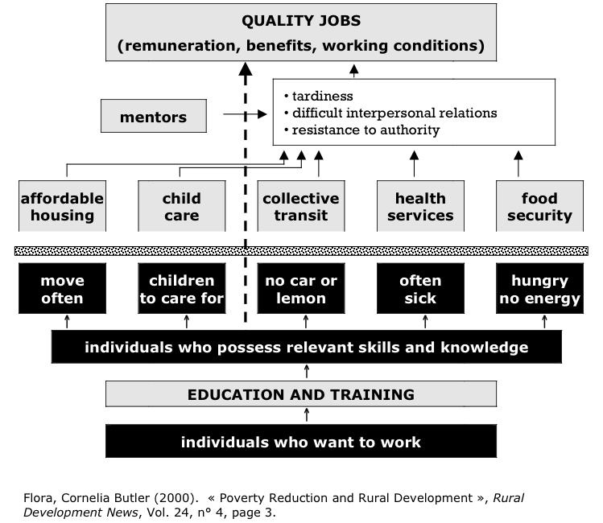

Slide 9
ANALYSIS AND DISCUSSION

Slide 10
ANALYTICAL QUESTIONS
For each step of the path to employment, what are possible roles for the private sector?
• What type of business is it?
• What is the size of the business?
• What is the industry?
• What benefits can the company derive from its participation?
• What might be obstacles to its participation ?

Slide 11
personal and professional qualification (1)
labour market entry or re-entry:
• job and life skills development programs

Slide 12
personal and professional qualification (2)
on-the-job training programs:
• internships (specific on-site educational programs)
• training businesses
job creation strategies:
• self-employment
• social entrepreneurship
• sectoral employment development
conventional job-training programs

Slide 13
eliminating obstacles (1)
social development initiatives:
• services related to social problems
• self-help groups and advocacy organizations
→ see next slide

Slide 14
eliminating obstacles (2)
transport
environnement
emploi, employabilité
logement
action bénévole
famille
alphabétisation
personnes handicapées
personnes âgées
jeunes
femmes
éducation populaire
économie
familiale
consommation
loisir
défense des droits
solidarité internationale
culture
communications
personnes immigrantes

Slide 15
eliminating obstacles (3)
initiatives providing direct support to individuals in need :
• foundations and charities
• service clubs
initiatives providing financing:
• community foundations
• microcredit, community loan funds

Slide 16
accompaniment
mentoring
labour market entry or re-entry:
• job and life skills development programs

Slide 17
favourable conditions for the creation of quality jobs
intermediary development ("backbone") organizations:
• analyze the local situation and plan, initiate, steer, coordinate, support and evaluate the activities required to meet needs

Slide 18
The challenge of integrated local development

Slide 19
THE CONTRIBUTION OF LOCAL ACTORS
Are present at each step:
educational institutions and other organizations provide professional qualifications
self-help groups reduce isolation and offer networking opportunities
community groups act to reduce numerous barriers
some agencies provide special accompaniment for specific categories of people (women, youth, immigrants ...)

Slide 20
COHESION MISSING IN ACTION
Each actor works completely independently.
Collaborations are generally uncommon.
When collaborative links do exist, they are more often between actors in the same sector.
This often arises from the uncoordinated implementation of public and private funding programs working in "silos".
Risk of duplication, missed opportunities.

Slide 21
ABSENCE OF KEY PLAYERS
Employer participation in the development, implementation and evaluation of initiatives is usually nonexistent.
There is no consensus on the role of the private sector in these initiatives.
Employers must be aware of the risks with which impoverished and excluded people must cope to access jobs.

Slide 22
LACK OF A COMPREHENSIVE STRATEGY
The lack of an overall strategy and key players means that there is:
no shared diagnosis of the current situation;
no collective understanding of the problem to solve or situation to improve;
no common vision of the desired changes in the short and medium terms.
A space is required to unite the various stakeholders and coordinate actions.

Slide 23
A SHARED RESPONSIBILITY
employers
mentors
services
JOB
self-help
training
accompaniment

Slide 24
A COMMON RESPONSIBILITY
>
employers
mentors
services
JOB
self-help
training
accompaniment

Slide 25
http://tamarackcommunity.ca/downloads/learning_centre/Collab_Business_072008.pdf

Slide 26
Coopérative de consultation en développement La Clé
Richard Leroux
William A. « Bill » Ninacs
(819) 758-7797
info@lacle.coop
http://www.lacle.coop/

