Slide 1
THE COMPETENT COMMUNITY: RESILIENT AND EMPOWERED
Bill Ninacs
Coopérative de consultation en développement La Clé
Victoriaville, July 2010

Slide 2
LA PRESSE, mardi 13 juillet 2010, A2

Slide 3
LA PRESSE, samedi 31 juillet 2010, A5

Slide 4
RESILIENCE = SURVIVAL?
OR = SUCCESS?

Slide 5
THE COMPETENT COMMUNITY

Slide 6
a competent community: provides access for its members to the resources that they require + members efficiently take advantage of this access

Slide 7
DIMENSIONS OF A COMMUNITY
INSTRUMENTAL | EXISTENTIAL
management and production of goods and services (resources) | sense of belonging, trust, solidarity and self-esteem
HEALTH AND WELL-BEING

Slide 8
REGULATED NETWORKS

Slide 9
FREE NETWORKS

Slide 10
THE RESILIENT COMMUNITY

Slide 11
a resilient community: can maintain or restore access to resources to meet members’ needs and can seize development opportunities in times of disruption
11

Slide 12
INTERSECTORAL ACTION
+
A COLLECTIVE PLAYER

Slide 13
CONSENSUS-BUILDING STAGE:
± formal and voluntary process: recognition of common problem (compromise is inevitable)
sharing of analyses and solutions
→ co-operative and conflictual dynamics
PARTNERSHIP STAGE:
project with constraints (contractual or moral) between specific players (partners)
specific mission, objectives, responsibilities and time frame
each partner has personal interests
→ power-based relationship

Slide 14
MOBILISATION
portrait → awakening → cycle :
Common Vision
Strategic
Planning
Project
Evaluation
Analysis (diagnosis)

Slide 15
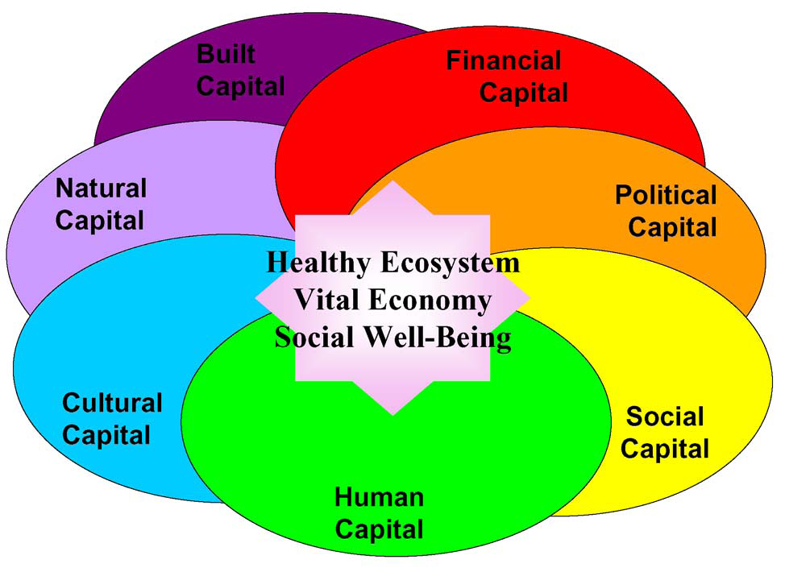
Community Capitals Model : Cornelia Flora, North Central
Regional Center for Rural Development

Slide 16
THE EMPOWERED COMMUNITY

Slide 17
to be empowered = to exert power ⬇ choose ➔ decide ➔ act

Slide 18
OUR DREAM

Slide 19
OUR REALITY

Slide 20
INDIVIDUAL
participation abilities self-esteem critical consciousness
COMMUNITY
participation abilities communications community capital

Slide 21
EMPOWERMENT

Slide 22
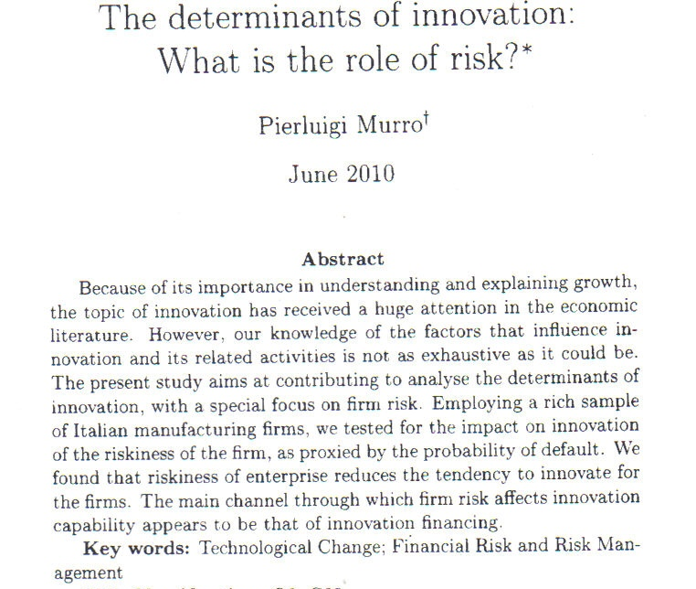
S.E.R.I.E.S. Working Paper No. 0032

Slide 23
THe ROLE OF The StatE

Slide 24
LOCAL AUTONOMY
MAIN ISSUE:
communities must be able to act autonomously in order to ensure long-term sustained effort (sustainability)
but must also act within the parameters imposed by funders that restrict local autonomy
and, funders often act within silos and without co-ordination

Slide 25
SUCCESSFUL PROGRAMS
a mixture of “top-down” firmness and clarity relating to overall goals and accountability requirements
and of “bottom-up” flexibility in the choice and management of local initiatives
accompanied by concensus among the divers concerned funders

Slide 26
SUCCESSFUL PROGRAMS: ENABLING FACTORS
local control over implementation by those affected by the outcomes
application processes involving local partnerships and technical assistance
medium and long term commitment for capacity-building programs (where required)
multi-year financing (on-going facilitation of partnerships) and competent technical assistance

Slide 27
Mobilising is not mechanical…

Slide 28
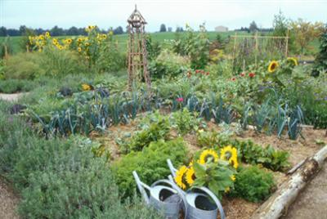
…but rather organic

Slide 29
BEFORE THE LAST WORD
Ring the bells that still can ring Forget your perfect offering There is a crack in everything That's how the light gets in.
Anthem, Leonard Cohen

Slide 30
THE LAST WORD
Il ne suffit pas d’être acteur de son développement, encore faut-il en être véritablement l’auteur.
(Michel Dinet, 1997)

Slide 31
reference: Intersectoral Action and Empowerment: Keys to Ensuring Community Competence and Improving Public Health by William A. Ninacs and Richard Leroux https://www.novapublishers.com/catalog/product_info.php?products_id=5819

Slide 32
Coopérative de consultation en développement La Clé
William A. « Bill » Ninacs
(819) 758-7797
info@lacle.coop
http://www.lacle.coop/

