Slide 1
local communities and wellness
William A. « Bill » Ninacs
2011 Provincial Wellness Conference “Building Momentum: The Wellness Movement in New Brunswick”
Moncton, March 2011

Slide 2
WELLNESS

Slide 3
WELLNESS
ongoing process
to enhance the many dimensions of well being
that enable people to reach and maintain their personal potential,
…and contribute to their communities

Slide 4
SEVEN DIMENSIONS OF WELLNESS
emotional
mental / intellectual
physical
social
spiritual
professional
environmental
University of California, Riverside : http://wellness.ucr.edu/seven_dimensions.html

Slide 5
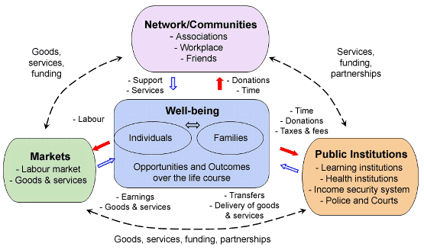
Human Resources and Skills Development Canada: http://www4.hrsdc.gc.ca/c.4nt.2nt@-eng.jsp?cid=14

Slide 6
Children's wellness: a shared responsibility
Parents
School
Childcare
Child
Library
Sports team
Pediatrician

Slide 7
Local community mobilisation

Slide 8
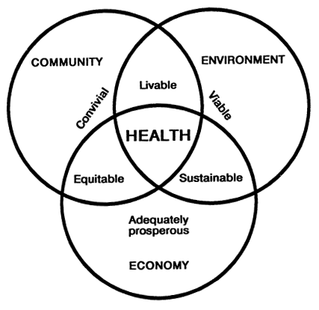
Hancock, Trevor (2001). “People, partnerships and human progress: building community capital”, Health Promotion International, 16(3), 275-280.

Slide 9
WE
Collective actor
Change sought:
Solving a problem
Responding to needs
Enhancing quality of life…
MOBILISATION
Collective action
COMMON PROJECT

Slide 10
Children's wellness: a COMMON responsibility
>
Parents
School
Childcare
Child
Library
Sports team
Pediatrician

Slide 11
Enabling factors
Interests: to bring people to the table + seriousness of the problem and timing
Ideals: to ensure sustained action + real possibility to act upon the situation
Common values: to build the WE and to ensure buy-in + experience in the community with one or more similar mobilisations

Slide 12
A mobilisation’s competence

Slide 13
DIMENSIONS OF A COMMUNITY
INSTRUMENTAL | EXISTENTIAL
management and production of goods and services (resources) | sense of belonging, trust, solidarity and self-esteem
HEALTH AND WELL-BEING

Slide 14
ASPECTS of networks
NORMATIVE | FREE
do for | do with
results | processes
planning, co-ordination, execution, evaluation | supporting mutual help and co‑operation
hierarchy (weak organizational autonomy) | consensus (strong organizational autonomy)
formal | informal
complementary (institutional systems) | collaboration (value systems)
Mission
Objectives
Activities
Management
Ties
Focus of Work

Slide 15
REGULATED NETWORKS

Slide 16
FREE NETWORKS

Slide 17
a COMPETENT mobilisation
The collective actor is able to:
get its members to work in an intersectoral fashion
and
successfully complete the stages of the development cycle

Slide 18
Intersectoral action
+
A collective actor

Slide 19
CONSENSUS-BUILDING STAGE
a more or less formal and voluntary consensus-seeking process
recognition of a common problem
sharing of analyses and solutions
→ co-operative and conflictual dynamics
→ compromise is inevitable
contributes to building the « WE »

Slide 20
PARTNERSHIP STAGE
project with constraints (contractual or moral) between specific actors (partners)
specific mission, objectives, responsibilities and time frame
each partner has vested interests
→ power-based relationship

Slide 21
THE DEVELOPMENT CYCLE
Initiation
stage 2
Diagnosis and common vision
stage 3
Strategic and operational planning
stage 4
Actions implemented
stage 5
Evaluation of
actions and mobilisation
stage 1
Portrait / Profile
Ongoing MOBILISATION

Slide 22
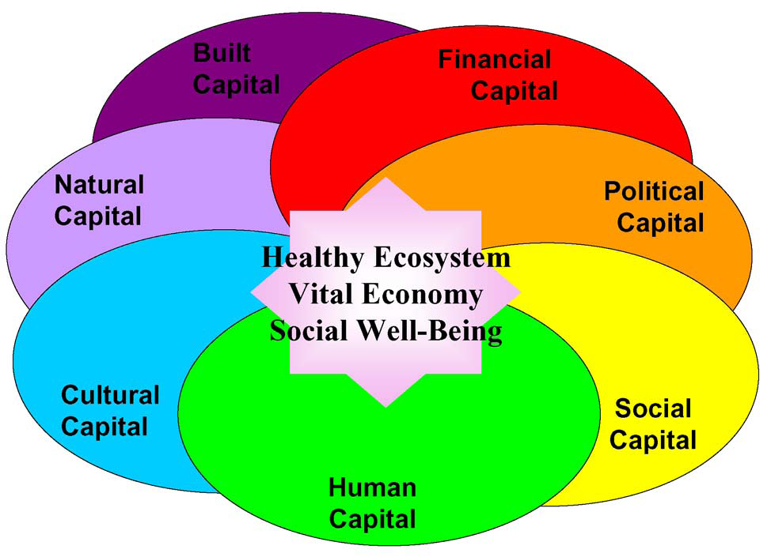
Community Capitals Model : Cornelia Flora, North Central Regional Center for Rural Development

Slide 23
THE EMPOWERED COMMUNITY

Slide 24
A Competent community
where its various systems are able to respond to the needs of its constituents
→ mobilisation
and where its constituents are able to use these systems efficiently
→ empowerment

Slide 25
to be empowered = to exert power ⬇ choose ➔ decide ➔ act

Slide 26
INDIVIDUAL
participation abilities self-esteem critical consciousness
COMMUNITY
participation abilities communications community capital

Slide 27
Individual Empowerment
PARTICIPATION | ABILITIES
SELF ESTEEM | CRITICAL CONSCIOUSNESS

Slide 28
Individual Empowerment
It's the presence of all of the different components of the process and especially their dynamic interaction that matter for the development of individual empowerment.

Slide 29
INDIVIDUAL
participation abilities self-esteem critical consciousness
COMMUNITY
participation abilities communications community capital

Slide 30
Community EMPOWERMENT
PARTICIPATION | ABILITIES
significant decisions · power-sharing · common vision · openness · process and results · learn · contribute | local strengths · networking · social capital · accountability · conflict resolution · resilience · networks of support
COMMUNICATIONS | COMMUNITY CAPITAL
positive interaction · divergence of opinions · trust · general and specific information · transparency | sense of belonging · sense of citizenship

Slide 31
EMPOWERMENT

Slide 32
OUR DREAM

Slide 33
OUR REALITY

Slide 34
Overview of empowerment
INDIVIDUAL
individual empowerment
participation abilities self-esteem critical consciousness
ORGANISATION
community
community empowerment
participation abilities communications community capital
community empowerment | organisational empowerment
participation abilities communications community capital | participation abilities recognition critical consciousness

Slide 35
Organisations that do not target empowerment
adopt an empowerment-oriented approach
including : - partner-based collaboration (active subjects) - action based on strengths perspective - clients = with rights (≠ beneficiaries)
means : - less certitude → persuasion - sharing of information and power : participation in decisions

Slide 36
THe ROLE OF The StatE

Slide 37
LOCAL AUTONOMY
MAIN ISSUE:
communities must be able to act autonomously in order to ensure long-term sustained effort (sustainability)
but must also act within the parameters imposed by funders that restrict local autonomy
and, funders often act within silos and without co-ordination

Slide 38
Challenges facing local actors
Change of perspective:
sectoral approach versus multisectoral and citizenship-based approach
Coherence in the deployment:
integrated action despite multiple initiatives and programs
Support:
equitable access to resources despite differences

Slide 39
CONSeQUENCES
Reduced efficiency and innovation
Disillusionment and distrust
Engagement linked to resources
Compromised sustainability
Territorial and sectoral inequities
Results and processes with uneven quality

Slide 40
SUCCESSFUL PROGRAMS
a mixture of “top-down” firmness and clarity relating to overall goals and accountability requirements
and of “bottom-up” flexibility in the choice and management of local initiatives
accompanied by concensus among the divers concerned funders

Slide 41
SUCCESSFUL PROGRAMS: ENABLING FACTORS
local control over implementation by those affected by the outcomes
application processes involving local partnerships and technical assistance
medium and long term commitment for capacity-building programs (where required)
multi-year financing (ongoing facilitation of partnerships) and competent technical assistance

Slide 42
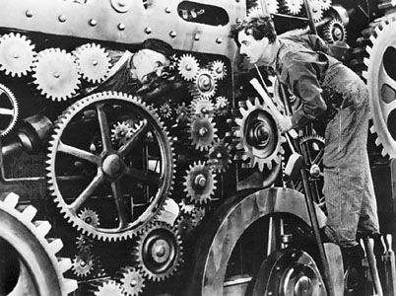
Mobilising is not mechanical…

Slide 43
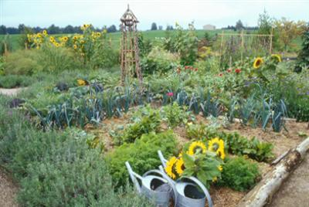
…but rather organic

Slide 44
THE LAST WORD
Il ne suffit pas d’être acteur de son développement, encore faut-il en être véritablement l’auteur.
(Michel Dinet, 1997)

Slide 45
REFERENCES (Internet): New Brunswick's Wellness Strategy : http://www.gnb.ca/0131/wellness-e.asp
Human Resources and Skills Development Canada: http://www4.hrsdc.gc.ca/c.4nt.2nt@-eng.jsp?cid=14

Slide 46
REFERENCE (written): Intersectoral Action and Empowerment: Keys to Ensuring Community Competence and Improving Public Health by William A. Ninacs and Richard Leroux https://www.novapublishers.com/catalog/product_info.php?products_id=5819

Slide 47
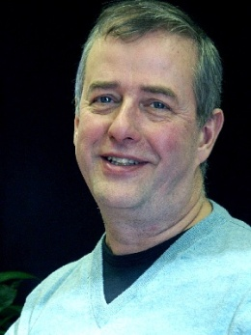
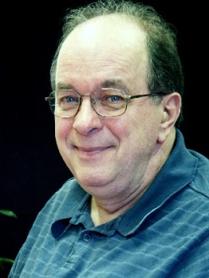
Coopérative de consultation en développement La Clé
Richard Leroux
William A. « Bill » Ninacs
(819) 758-7797
info@lacle.coop
http://www.lacle.coop/

